Slide 1
TPP – SystmOne
Hepatitis C –Report Suite

Slide 2
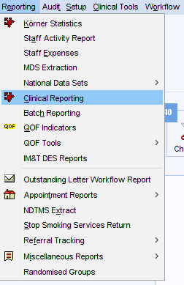
How to run the HEP C Reports
Log in to SystmOne
Click Reporting (along the top)
Click Clinical Reporting

Slide 3
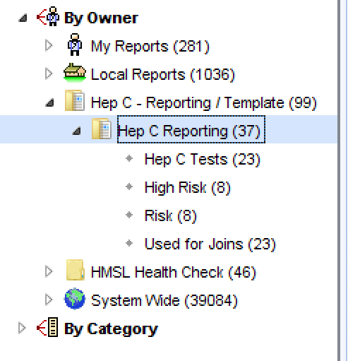
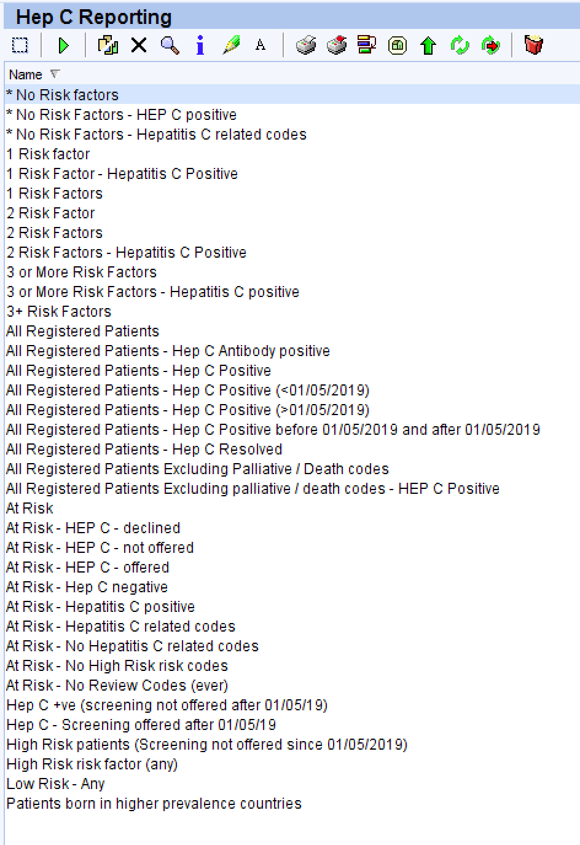
Running the Hep C Reports
Locate the folder down the left side called ‘HEP C – Reporting / Template’
Inside this folder is another called ‘Hep C Reporting’
Click on this folder to see various reports that can be run to show different cohorts of patients
Choose a report you want to run and right click the report and click ‘Run’
Once the reports have finished – right click and click ‘show patients’ to see the results

Slide 4
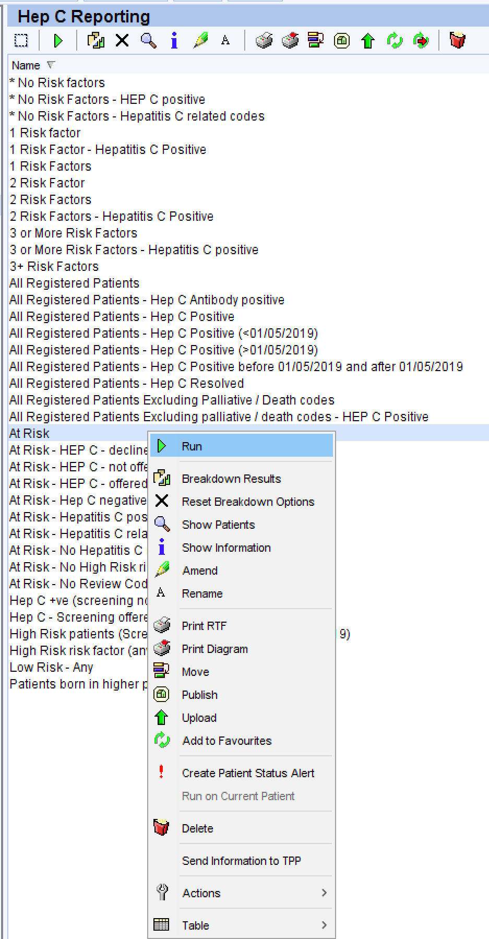
Run the ‘At Risk’ patients report
Locate the folder down the left side called ‘HEP C – Reporting / Template’
Inside this folder is another called ‘Hep C Reporting’
Right click on the ‘At Risk’ report and choose run
Once the reports have finished – right click and click ‘show patients’ to see the results
This will give you a list of patients who are in the At risk category

Slide 5
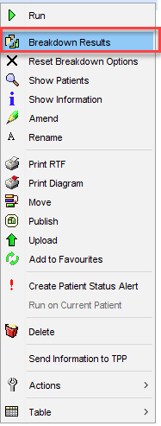
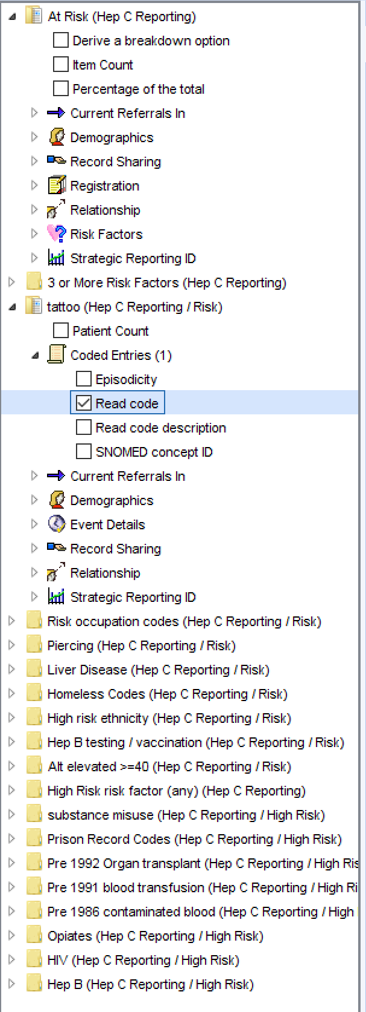
Breakdown Results
If you require to breakdown the results from the report. For example to see what codes are present in the patients record for them to appear in the results.
Right click the report you want to breakdown and click ‘breakdown results’
Depending on the report the number of breakdown options will change. In this example (high risk) we can breakdown each of the read codes in the reports – open each folder down the left hand side and click coded entries, then tick read code. Do this for all folders then click refresh at the top.
This will breakdown the results to patients and the codes. You can now right click on any group you want to see and choose ‘show patients’

