Slide 1
TPP – SystmOne
Hepatitis C –Report Suite
Installation Guide

Slide 2
Request access to the Hep C reports
Contact your local ODN Hep C lead to discuss taking part in the pilot phase of the programme.
They will need:
Your name
Surgery name
Practice ID
You will receive a reply when your surgery has been added to the group

Slide 3
Accepting access to the group
Once you have the email with access granted
Log in to SystmOne
Navigate to:
Workflow
Task list
You will have a new task inviting you to join the ‘Hep C - Reporting / Template’ organisation group
Right click on the task and click ‘Action’

Slide 4
Hep C reporting suite
Restart SystmOne
You will now have access to the following:
Hep C reporting folder (clinical reporting)
Hep C Screening template (clinical template)
2x Hep C patient status alerts
Hep C view (setup – data output – view maintenance)

Slide 5
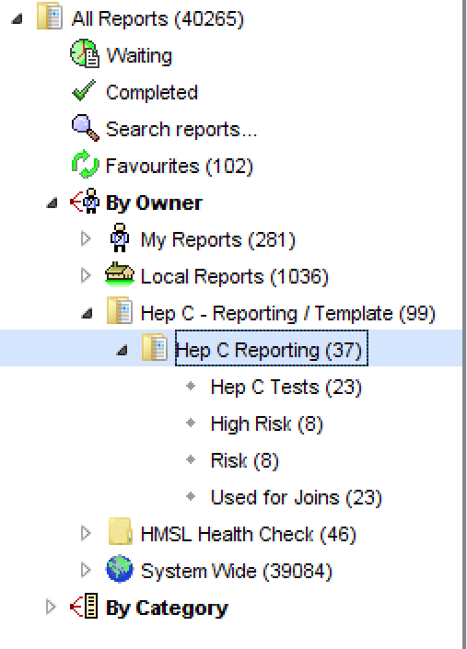
Hep C reports
Navigate to:
Reporting
Clinical Reporting
You will then see a folder named:
Hep C Reporting / Template
Hep C Reporting
This means you now have access to the full Hep C reporting suite

Slide 6
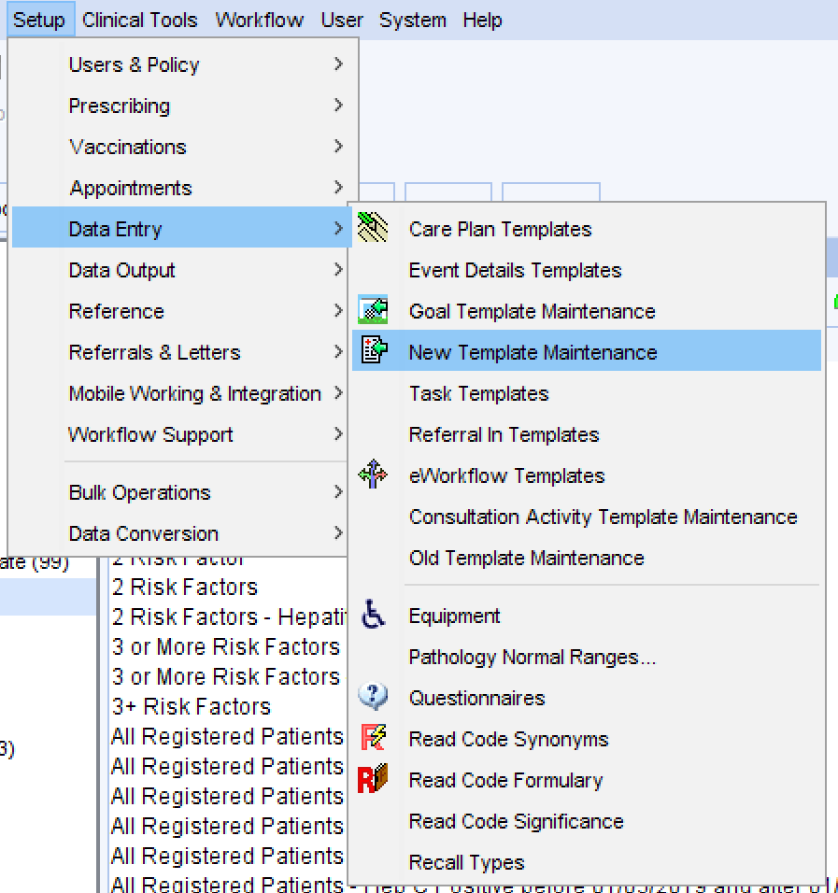
Hep C Template
Navigate to:
Setup
Data Entry
New Template Maintenance
You will then see a folder named:
Hep C Screening
In here you will be able to see the clinical template. To make it easier to use it is recommended that you add it to your surgeries clinical tree.

Slide 7
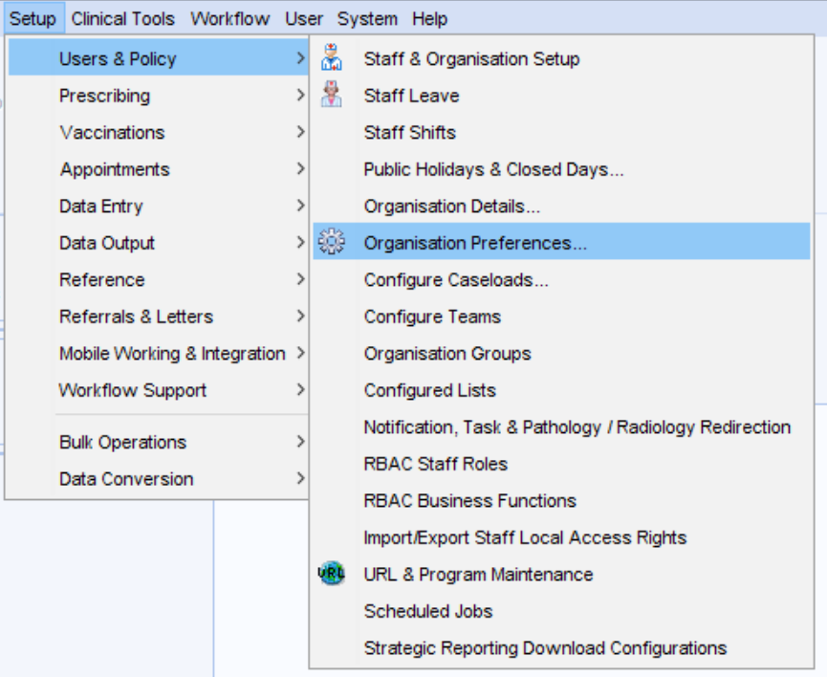
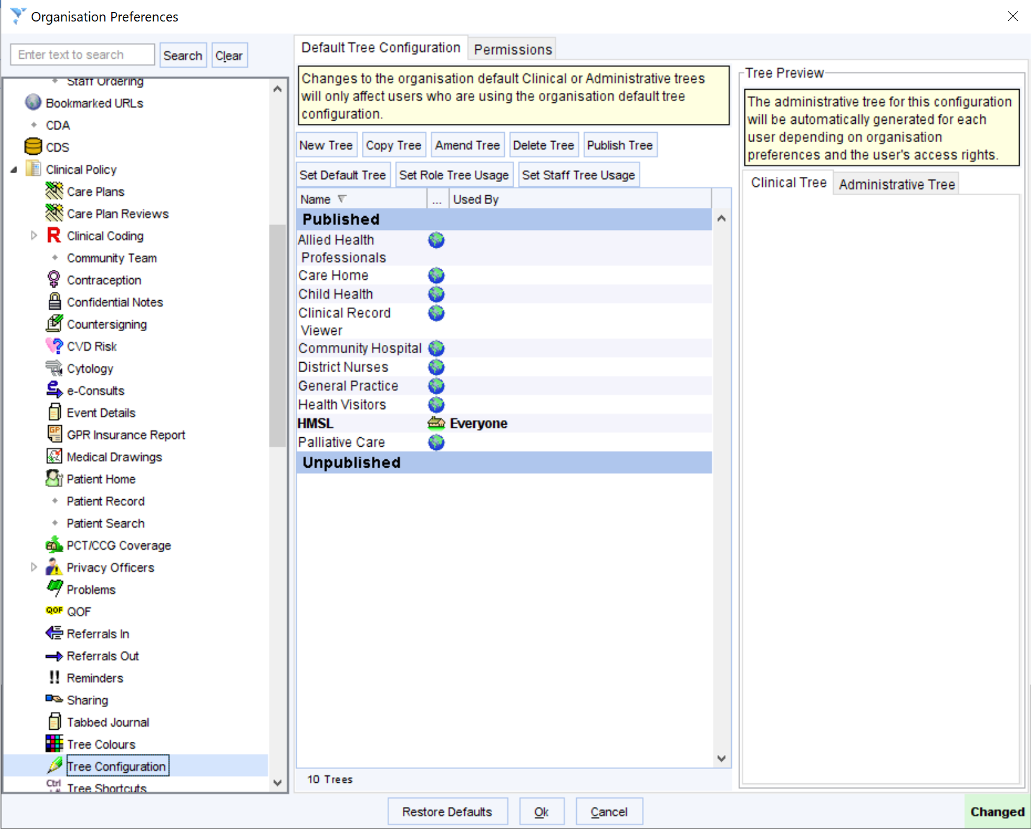
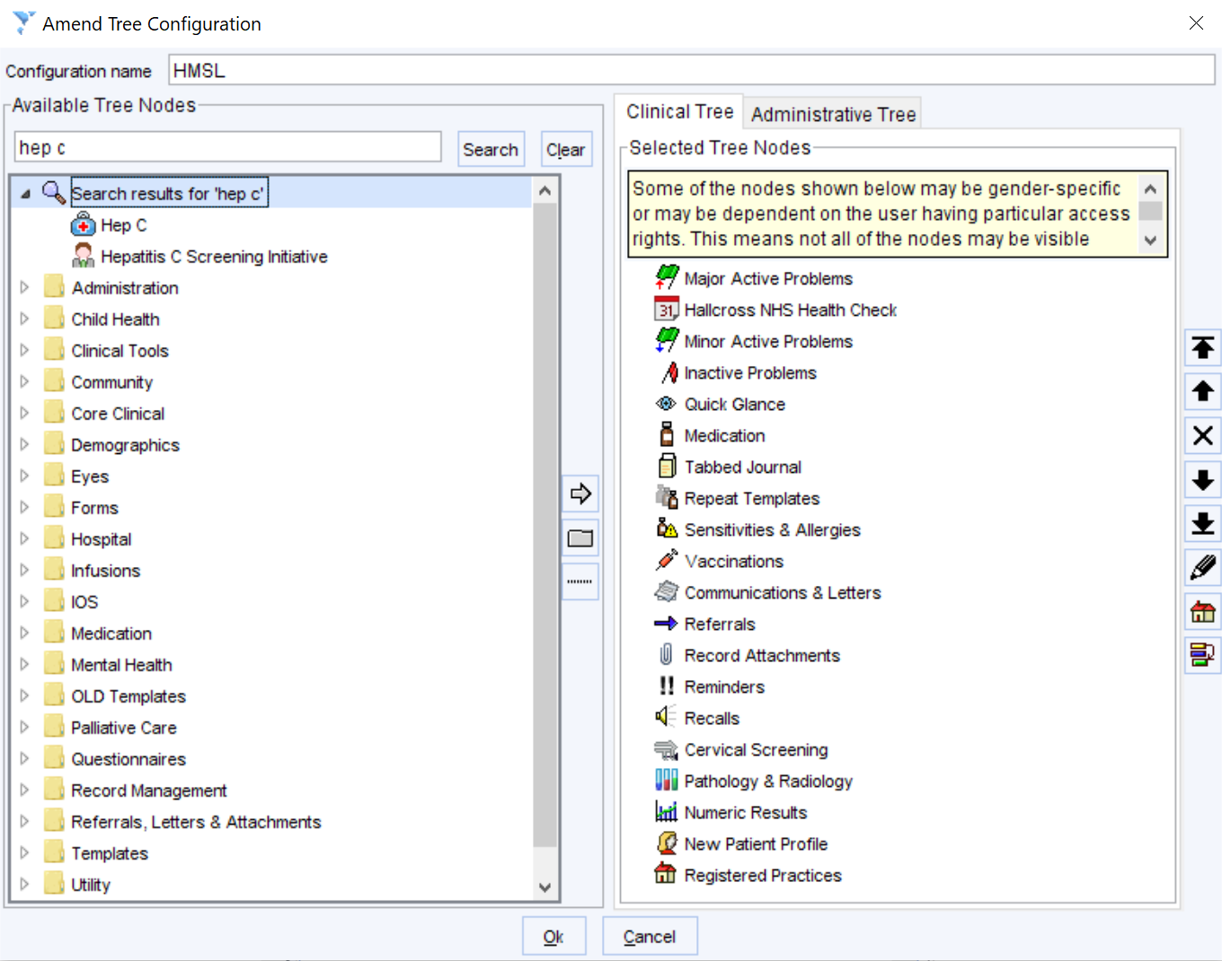
Add Hep C Template to the clinical tree
Navigate to:
Setup
Users & Policy
Organisation Preferences
In organisation preferences navigate to:
Clinical policy
Tree Configuration
In here you will see the tree that has been configured for your practice.
Select the correct tree and press amend tree
Search for ‘Hep C’ on the right hand side
Then double click ‘Hepatitis C screening initiative’ to move it to the clinical tree on the left hand side
Press ok on both windows to save

Slide 8
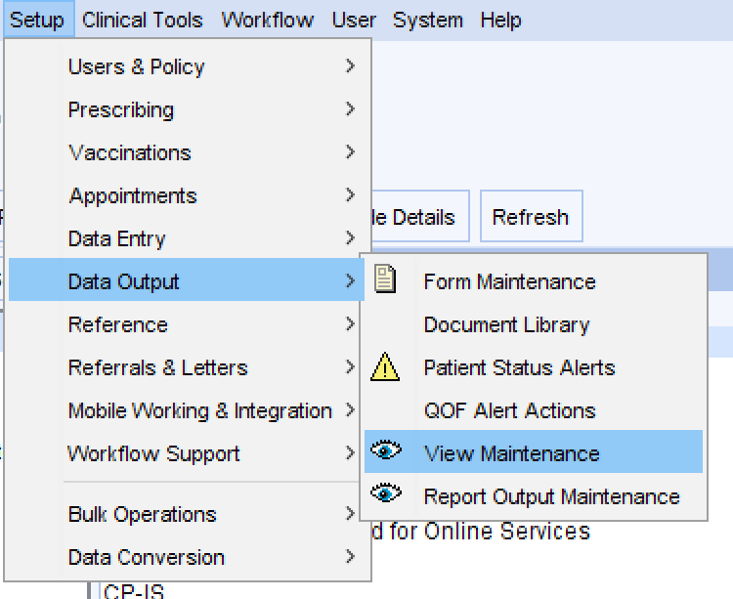
Hep C View
Navigate to:
Setup
Data Output
View maintenance
You will then see a view called ‘Hep C’
If the tick in active is not there please add, this is the view that is used in the clinical template and will be missing without this ticked

Slide 9
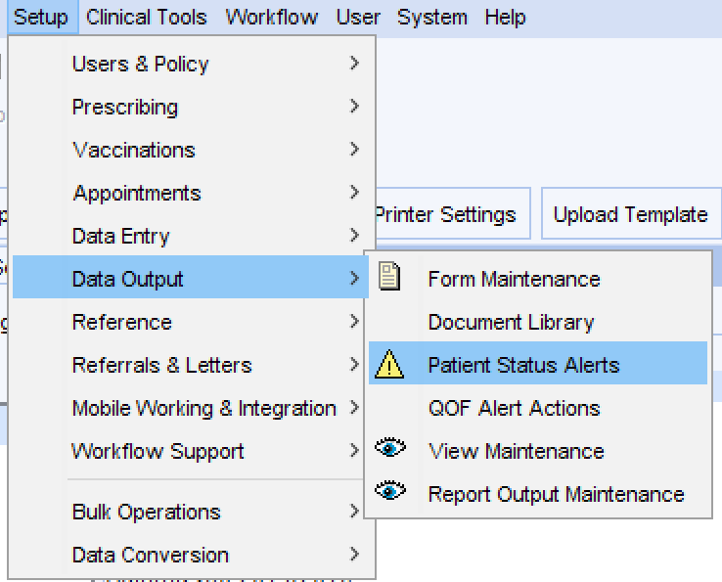
Hep C Patient Status Alerts
Navigate to:
Setup
Data Output
Patient status Alerts
You will then see 2 status alerts
Hep C +ve No screening offered
High Risk – No screening offered
If you do not want to use these at your surgery you can untick the ‘enabled’ box next to them to turn them off at your surgery.

